Slide 1
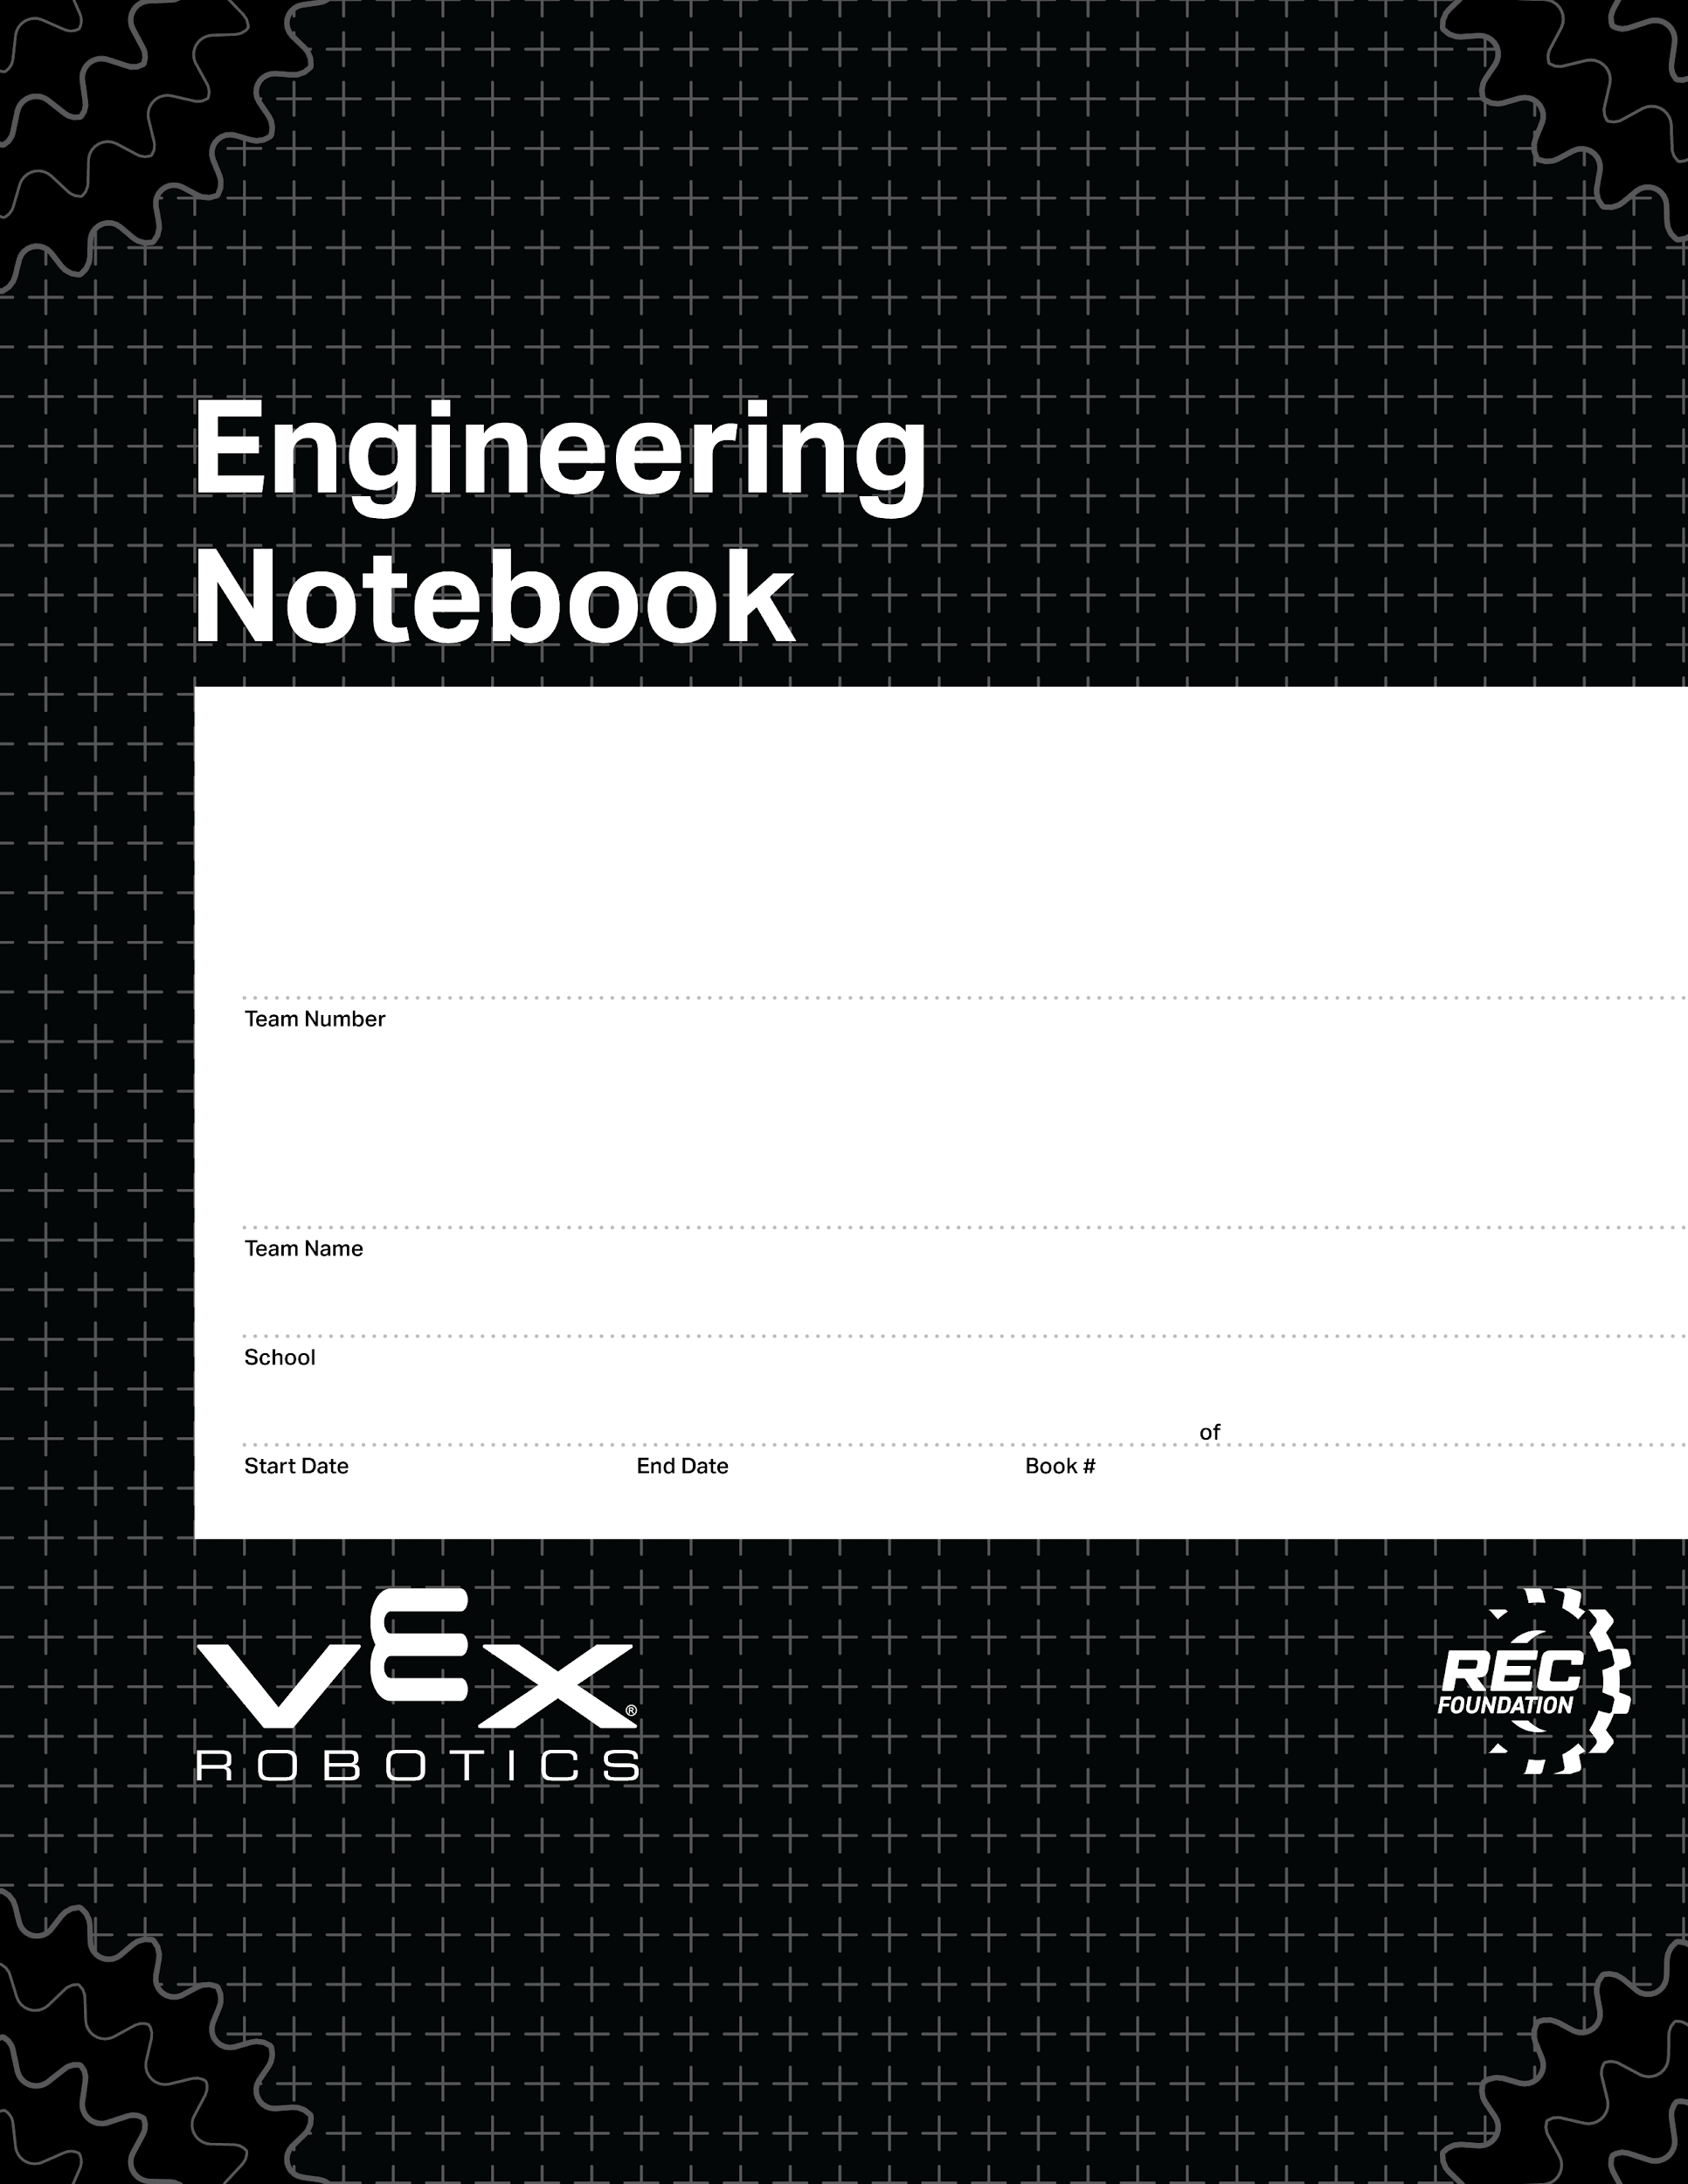
Digital V5 Parts
V5 Parts for Digital Notebooks
V2.1 Date 6.12.23

Slide 2
Changelog
V2.1 Date 6.12.23
Added controller/brain map template versions to library
Added V5 Pneumatics Kit
V2.0 Date 5.15.23
Added Scoring Object for 2023-2024 “Over Under” Game
Added side views for gear kit gears

Slide 3
Full Scale Parts
Electronics
Pneumatics
Motion - Sprockets
Motion - Gears
Motion - Wheels
Motion - Tread
Structure - Metal
Structure - Retainers
Game Elements - Over Under
Half Scale Parts
Electronics
Pneumatics
Motion - Gears & Sprockets
Motion - Tread
Motion - Wheels
Structure - Metal
Structure - Retainers
Game Elements - Over Under
Third Scale Parts
Electronics
Pneumatics
Motion - Gears & Sprockets
Motion - Wheels
Structure - Metal
Structure - Retainers
Game Elements - Over Under
You can use Find to quickly get to parts.

Slide 4

Identifying Parts
Once you copy a part out of this document and into your notebook, you may forget which part it is. We made it easy to identify parts anytime.
The part below can be identified by
Right click on the part
Select Alt Text
The part number (276-8330) is shows as the Title
The part name (32T 6P Sprocket) is shown as Description

Slide 5
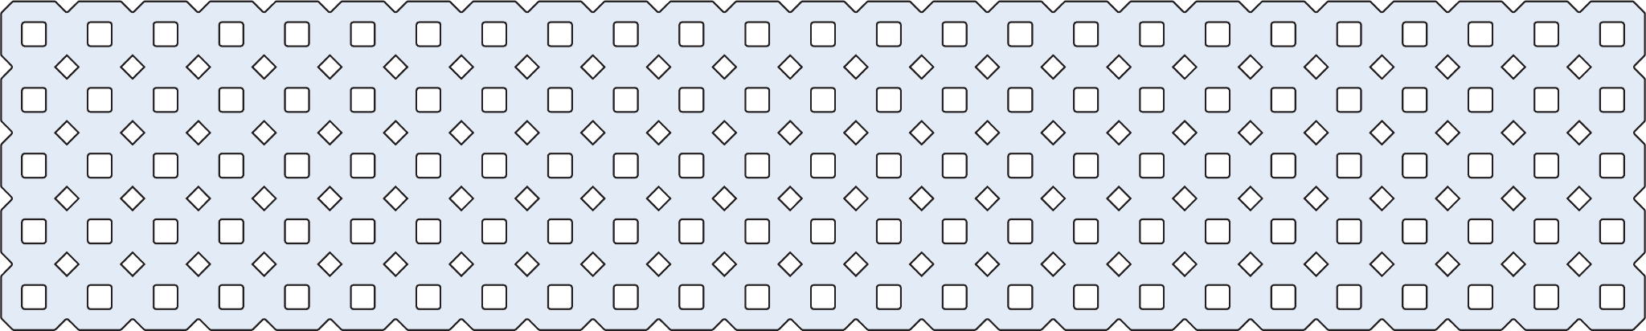
Changing Part Color
You can change the color by using Recolor.
Right click on the part
Select Format Options
Select Recolor
Use the Recolor drop down menu to select a new color
Super tip!
Not happy with your recolor options? Go to View > Theme Builder > Theme Colors and change your accent colors to match the colors you want.

Slide 6
Rulers - Full Scale, Half Scale, Third Scale
Third Scale
These rulers make measuring parts easy.
There are horizontal and vertical Rulers.
There are rulers for Full Scale, Half Scale and Third Scale
Place the Rulers next to, under or over your drawings to measure hole counts
Half Scale
Full Scale

Slide 7
Full Scale V5 Parts

Slide 8
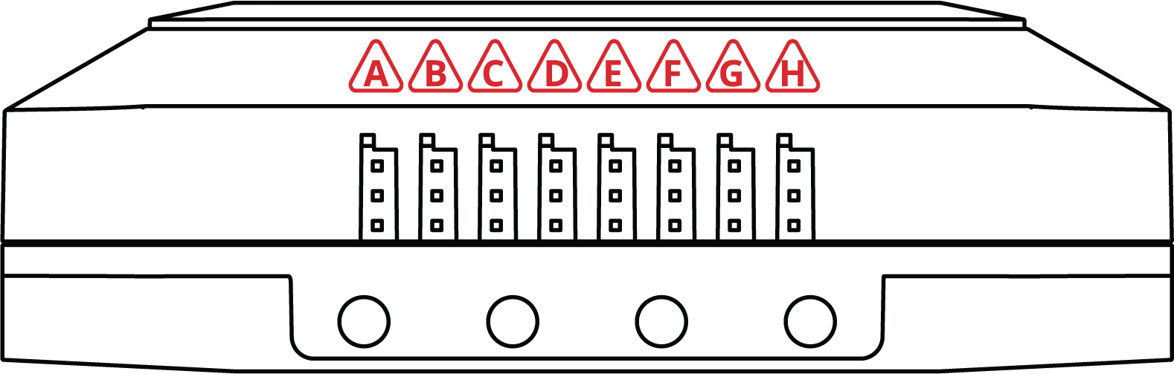
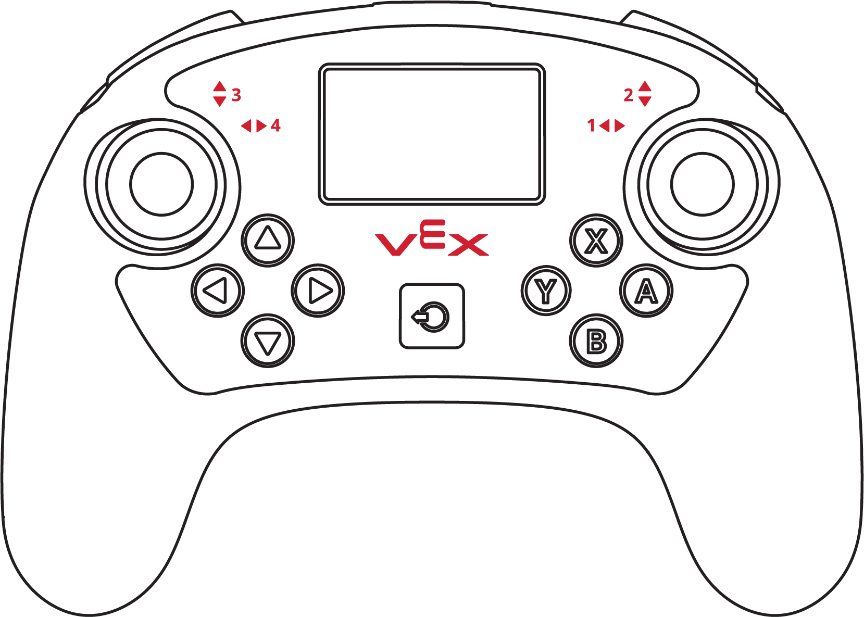
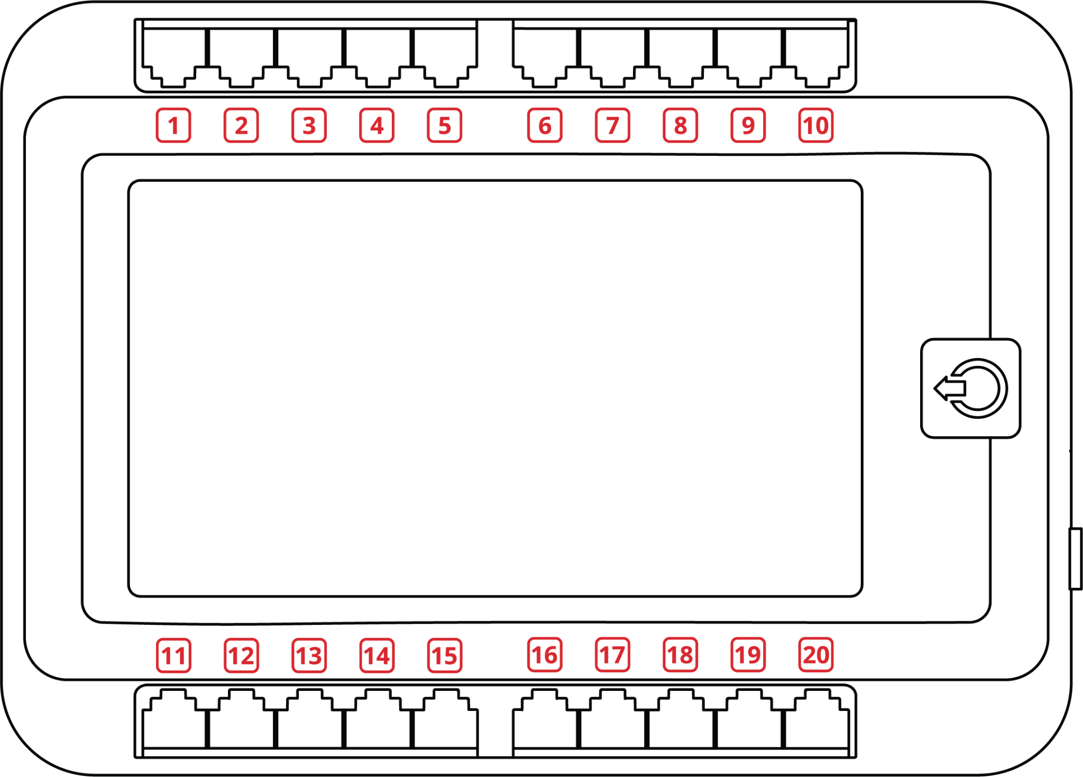
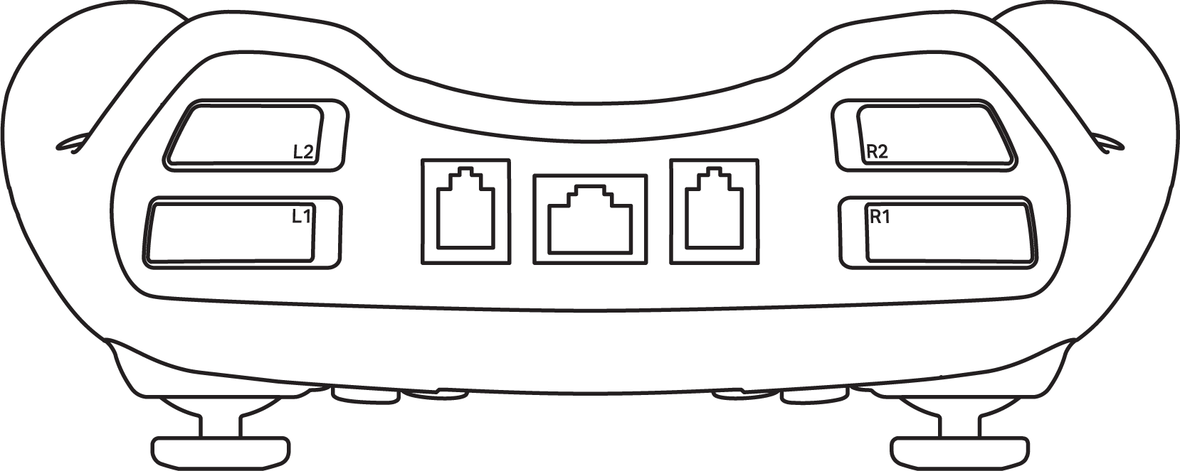
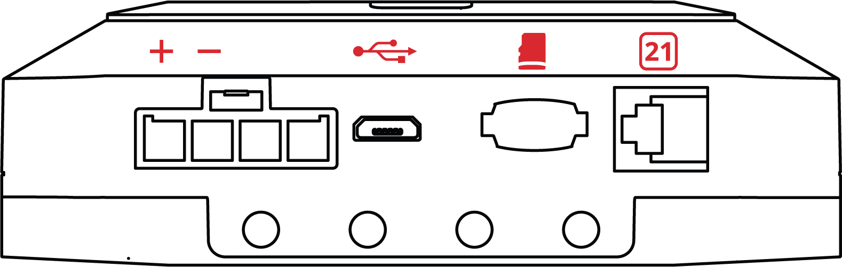
Electronics - Parts Map Outlines

Slide 9
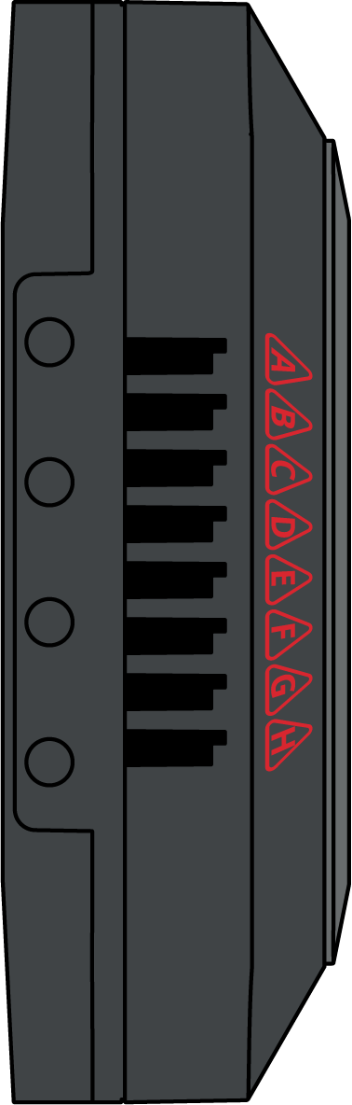
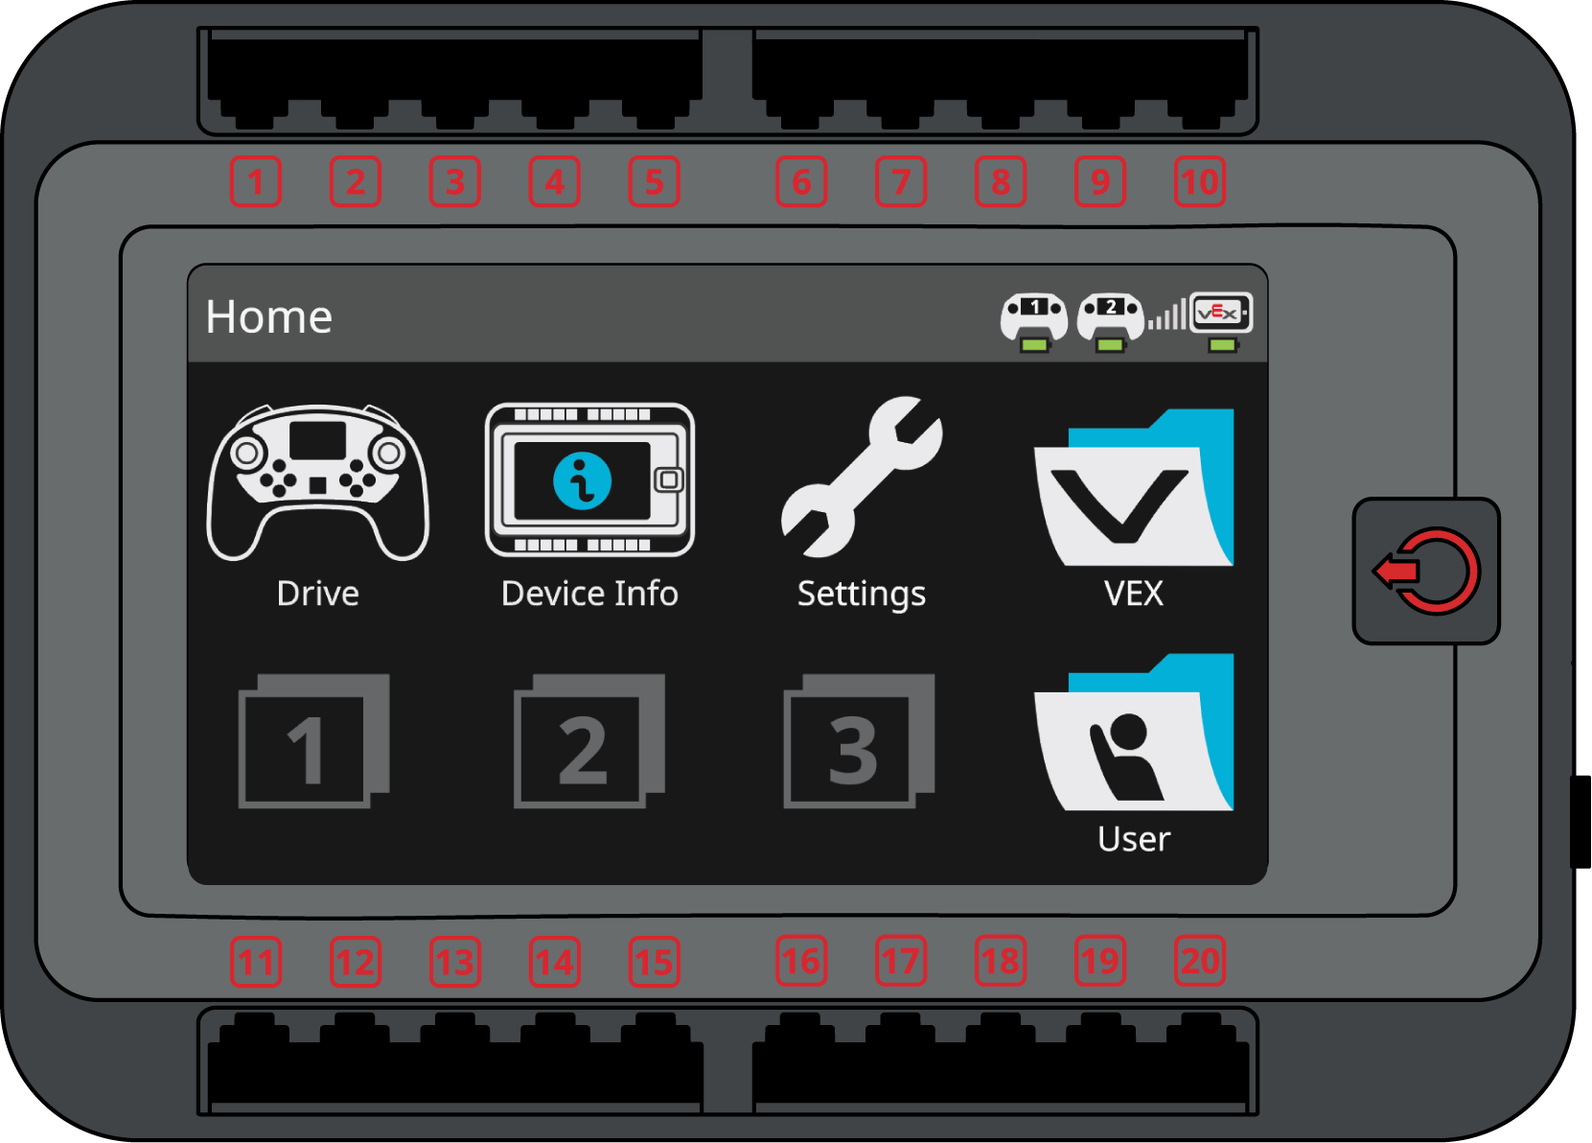
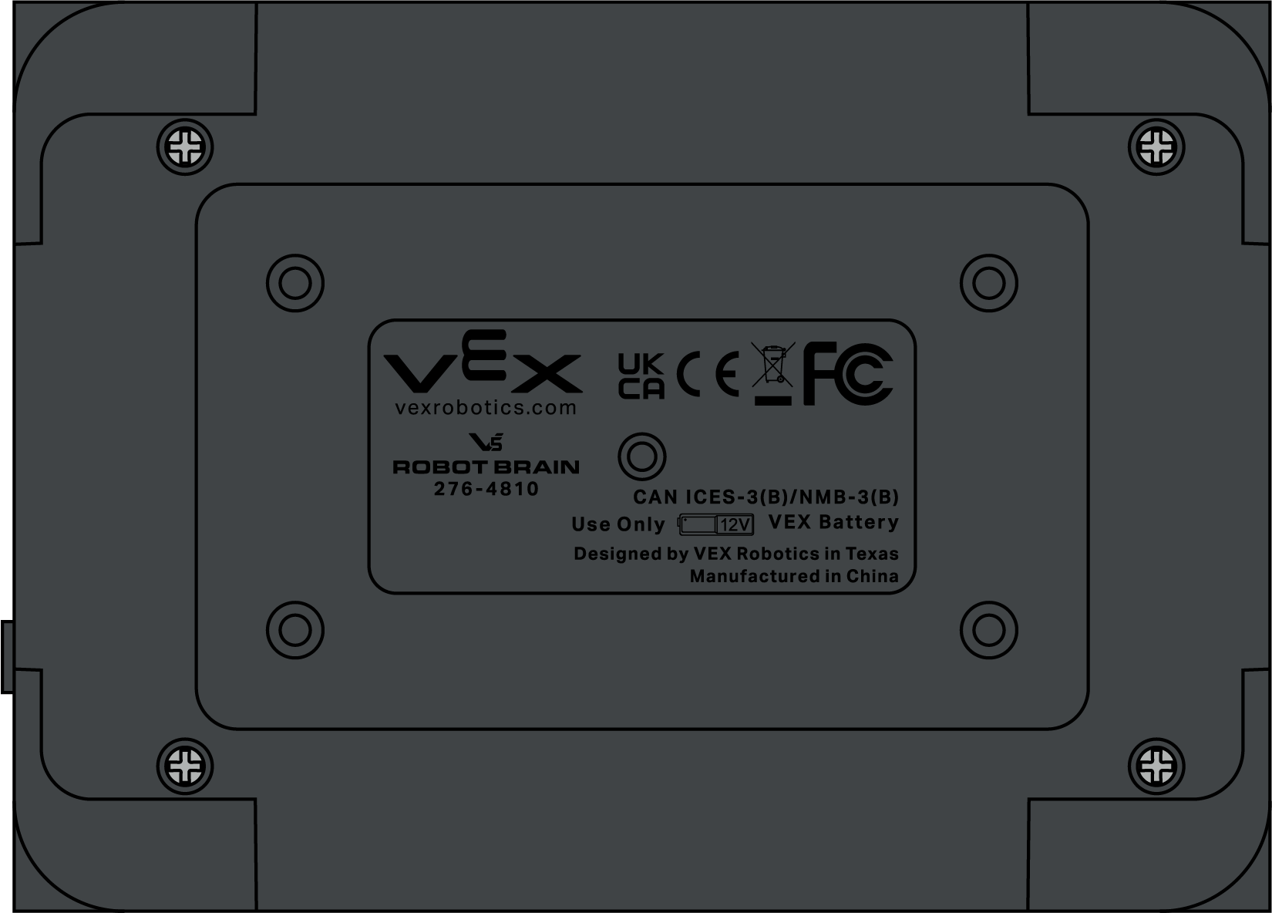
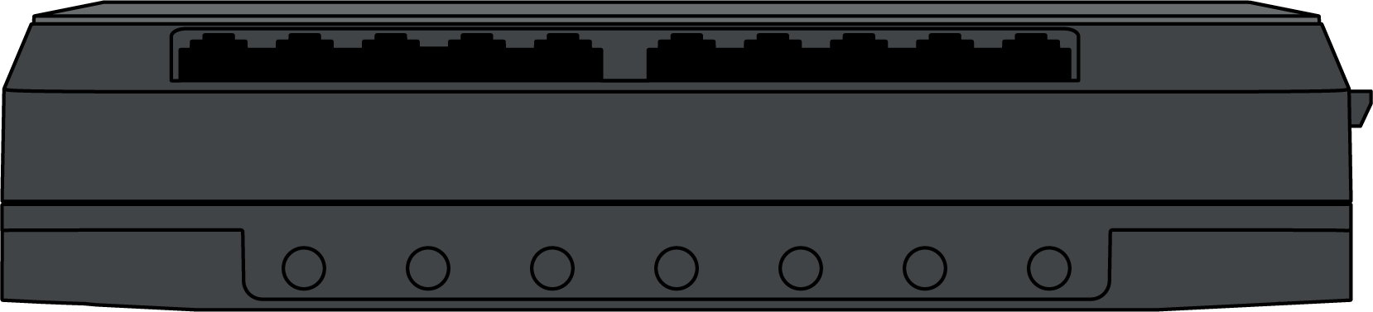
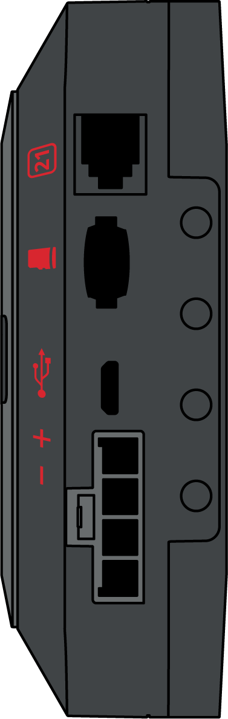
Electronics - Brain (Full Scale)
V5 Robot Brain
276-4810

Slide 10
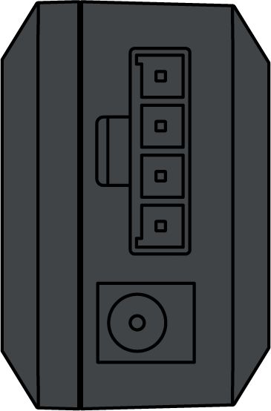
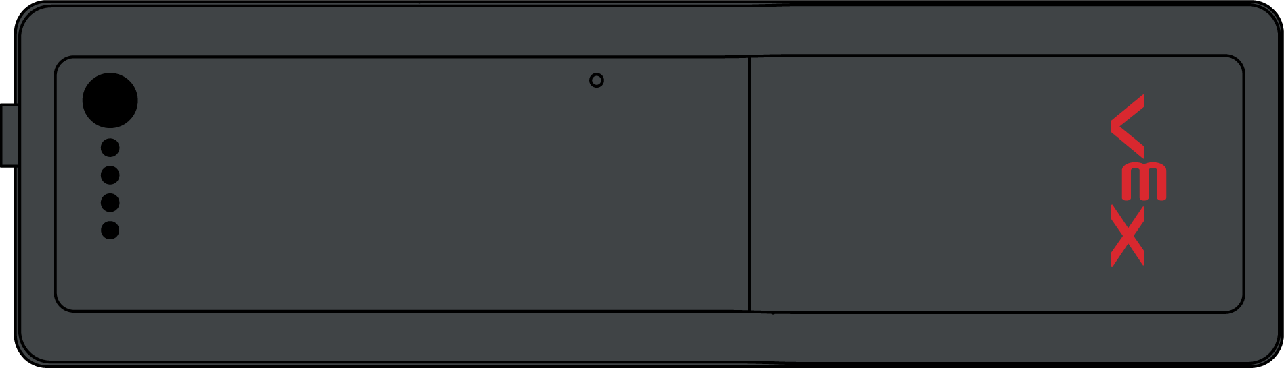
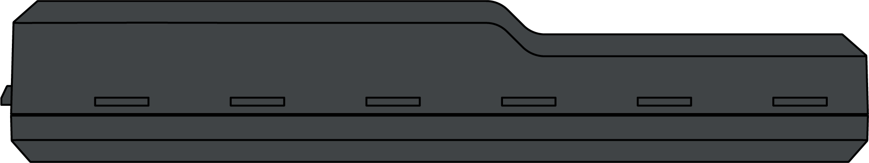
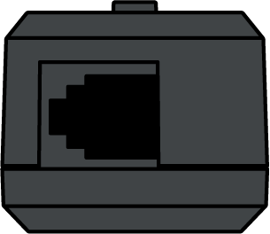
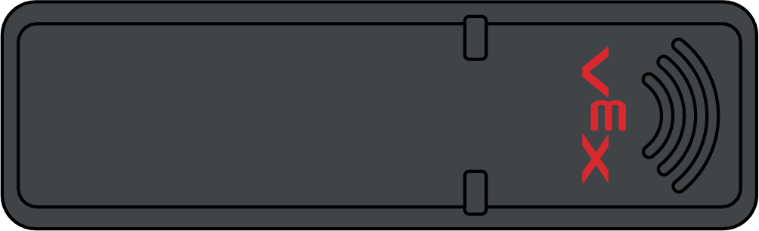
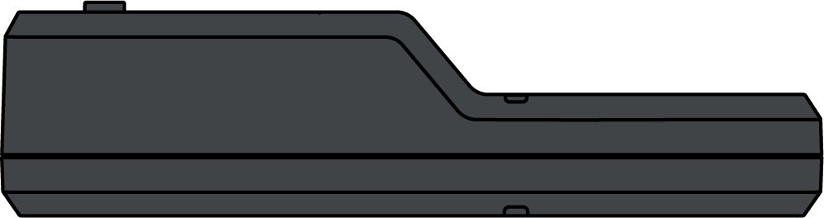

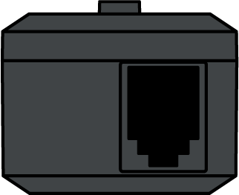
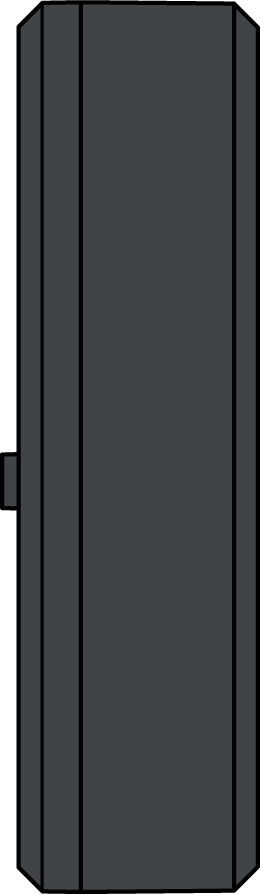


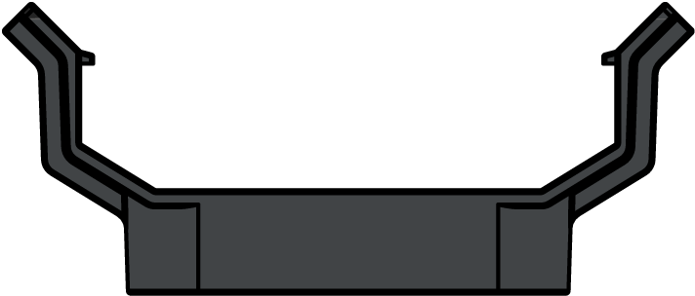

Electronics (Full Scale)
V5 Robot Battery
276-4811
V5 Robot Radio
276-4831
3-Wire Expander
276-5299
V5 Battery Clip
276-6020

Slide 11
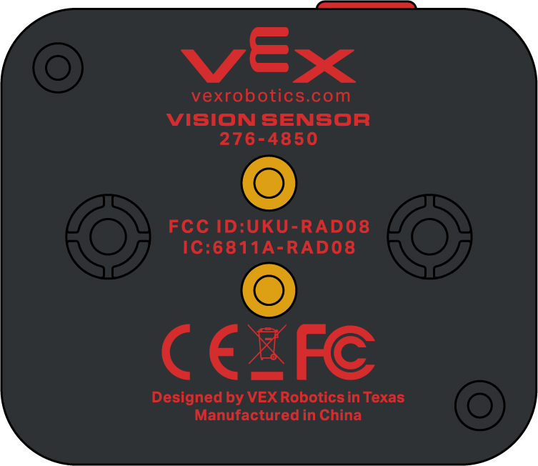
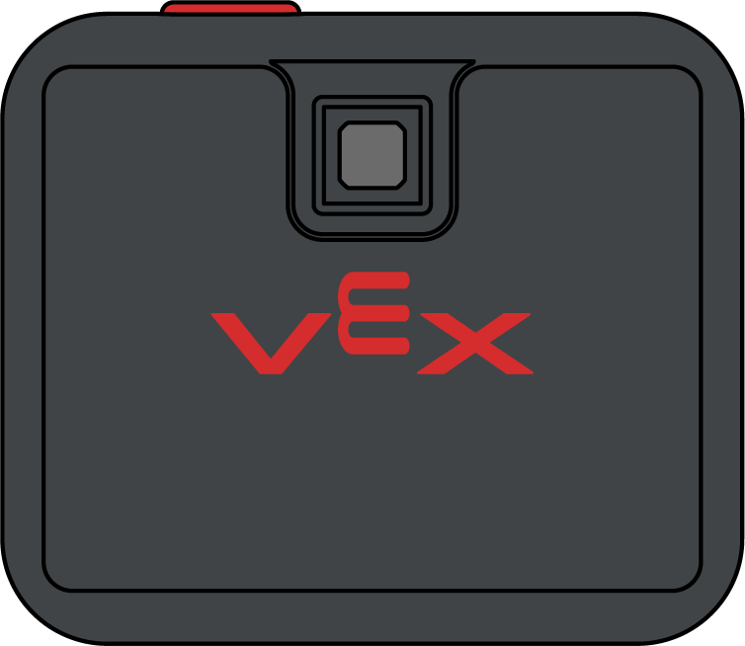
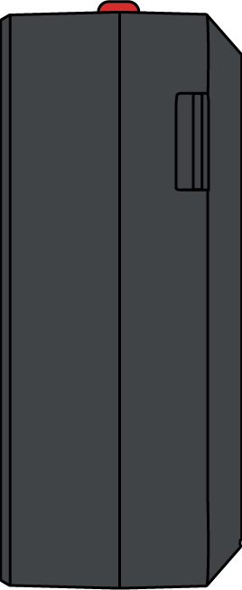
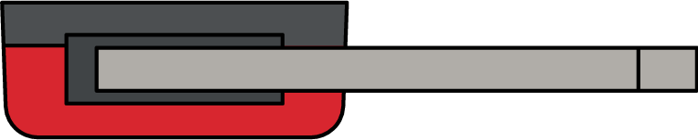


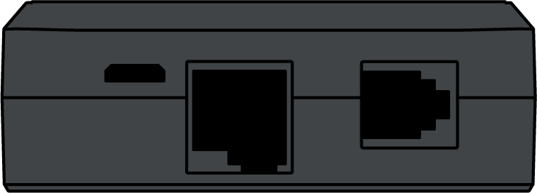
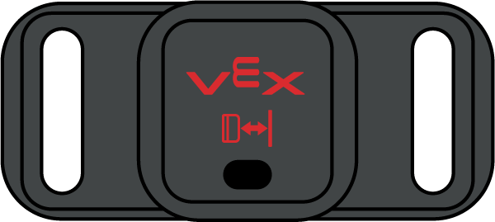
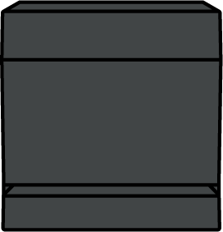
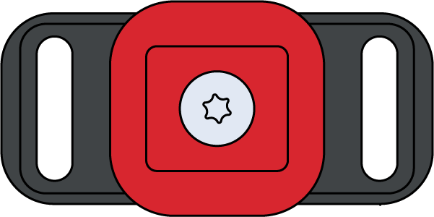

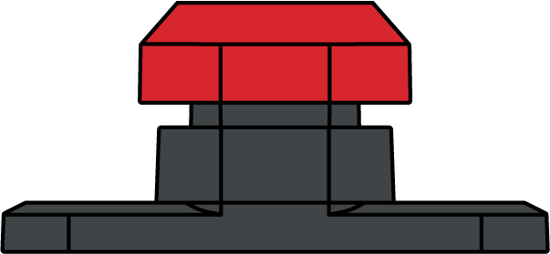



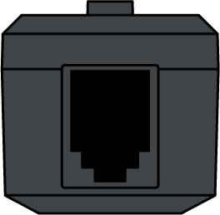

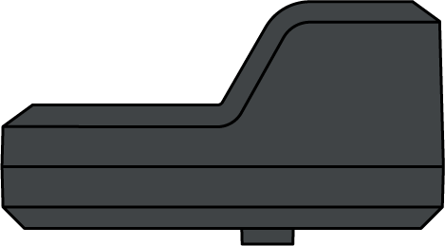
Electronics (Full Scale)
Vision Sensor
276-4850
Limit Switch
276-2174
V5 Distance Sensor
276-4852
Bumper Switch V2
276-4858
Inertial Sensor
276-4855
Line Tracker
276-2154

Slide 12
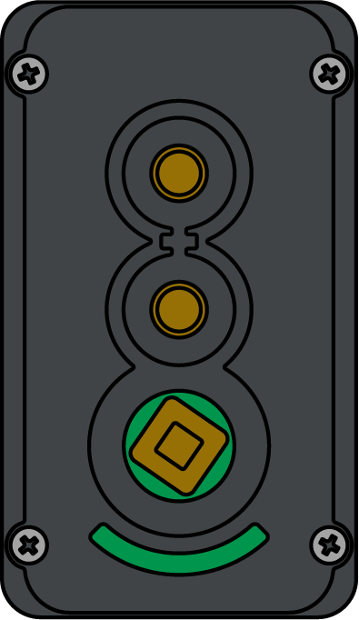
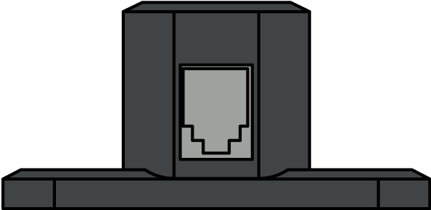
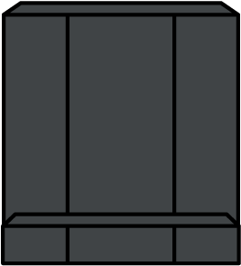
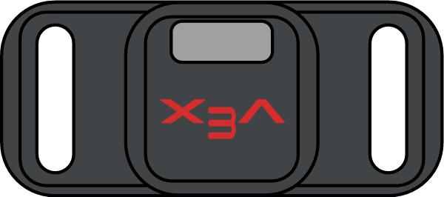
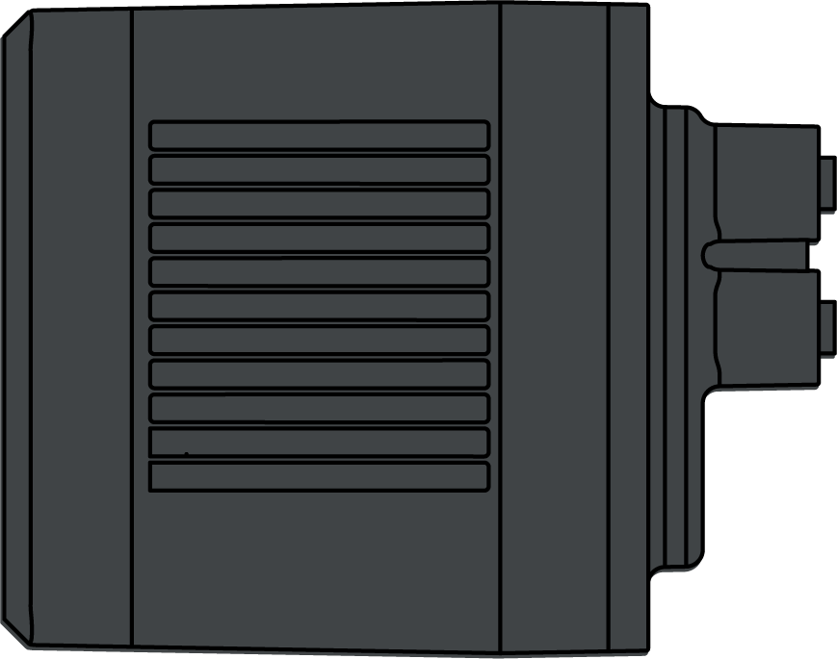
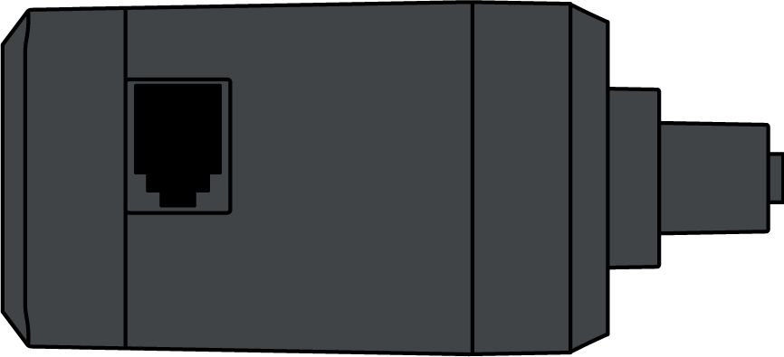
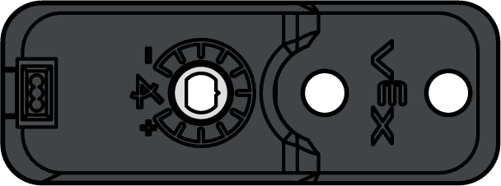

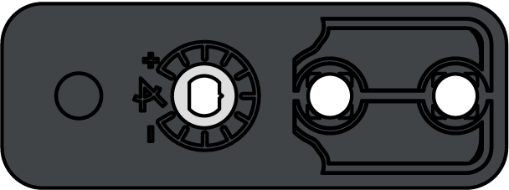
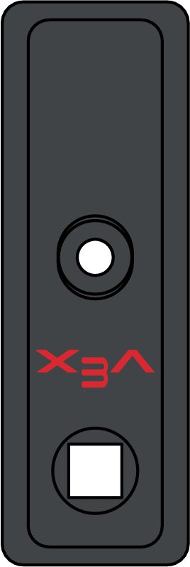
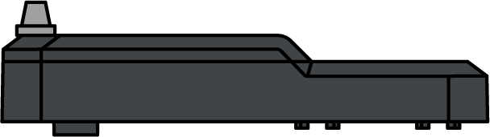


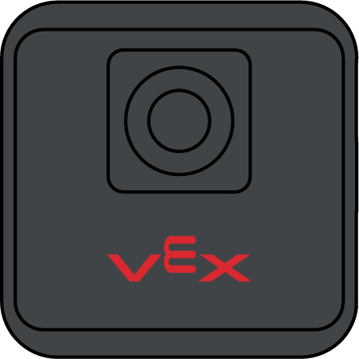
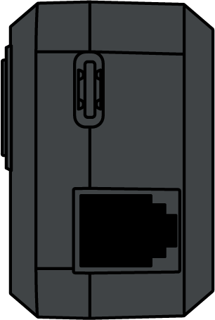
Electronics (Full Scale)
V5 Optical Sensor
276-7043
V5 Smart Motor
276-4840
Potentiometer V2
276-7417
V5 Rotation Sensor
276-6050
GPS Sensor
276-7405

Slide 13

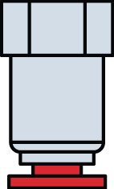








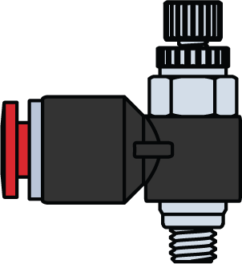

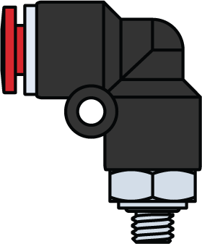



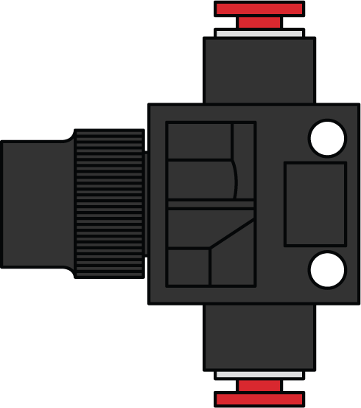
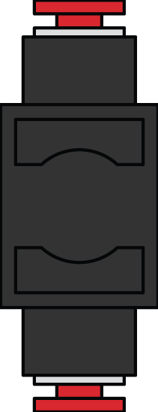

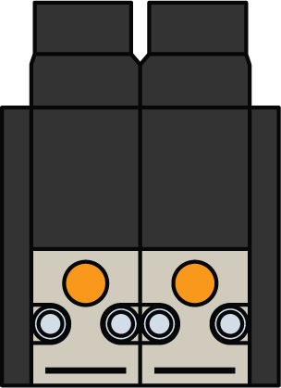


Pneumatics (Full Scale)
Straight Male Fitting
276-8750-800
Straight Male Fitting
276-8750
Straight Female Fitting
276-8750
Air Flow Valve Fitting
276-8750
Elbow Fitting
276-8750
Tee Fitting
276-8750
Shut Off Valve Fitting
276-8750
Double Acting Solenoid
276-8750

Slide 14







Pneumatics (Full Scale)
200mL Air Tank
276-8750
25mm Stroke Pneumatic Cylinder
276-8750
50mm Stroke Pneumatic Cylinder
276-8750
75mm Stroke Pneumatic Cylinder
276-8750
4mm Plug
276-8750
Valve Stem
276-8750
Air Pressure Regulator + Mounting Bracket
276-8750
Air Pressure Gauge
276-8750

Slide 15










Motion - Sprockets (Full Scale)
High Strength 18T Sprocket
276-2252-005
High Strength 30T Sprocket
276-2252-007
High Strength 12T Sprocket
276-2252-004
High Strength 24T Sprocket
276-2252-006
High Strength 6T Sprocket
276-2252-003

Slide 16









Motion - Sprockets (Full Scale)
24T 6P Sprocket
276-8329
40T 6P Sprocket
276-8331
16T 6P Sprocket
276-8328
32T 6P Sprocket
276-8330
8T 6P Sprocket
276-8030

Slide 17










Motion - Sprockets (Full Scale)
15T Sprocket (3P)
276-2166-003
48T Sprocket (3P)
276-2166-006
10T Sprocket (3P)
276-2166-002
40T Sprocket (3P)
276-2166-005
24T Sprocket (3P)
276-2166-004

Slide 18










Motion - Gears (Full Scale)
High Strength 60T Gear V2
276-7748
High Strength 84T Gear V2
276-7749
High Strength 48T Gear V2
276-7573
High Strength 72T Gear V2
276-7574
High Strength 36T Gear V2
276-7747

Slide 19








Motion - Gears (Full Scale)
Gear Kit 12T Gear 276-2169-001
Gear Kit 84T Gear 276-2169-004
Gear Kit 60T Gear 276-2169-003
Gear Kit 36T Gear 276-2169-002

Slide 20

















Motion - Gears (Full Scale)
High Strength 24T Gear
276-7572-001
12T Metal Pinion
276-2250-008
12T Metal Gear
276-7368
Rack Gear V2
276-4782-001
Worm Wheel
276-2184-002
Worm Gear
276-2184-003
Differential Frame
276-2184-001
24T Bevel Gear
276-2184-004

Slide 21




Motion - Gears - Turntable Bearings (Full Scale)
60T Small Turntable Bearing
276-5652-004
84T Large Turntable Bearing
276-5652-000

Slide 22










Motion - Tread (Full Scale)
Tank Tread Links
276-2168-002
Intake Roller
276-1499
Tank Tread Drive / Idler Wheel
276-2168-003

Slide 23






Motion - Tread (Full Scale)
Single Bogie Wheel
276-2168-004
Double Bogie Wheel
276-2168-005

Slide 24




Motion - Wheels (Full Scale)
2.75” Wheel
276-1496
Wheel Kit - Small Wheel
276-2164

Slide 25




Motion - Wheels (Full Scale)
3.25" Traction Wheel
276-3525
3.25” (260mm Travel) Anti-Static Wheel
276-7771

Slide 26




Motion - Wheels (Full Scale)
4” High Traction Tire
276-1489
4” Wheel
276-1497

Slide 27




Motion - Wheels (Full Scale)
Wheel Kit - Large Wheel
276-2164
Wheel Kit - Medium Wheel
276-2164

Slide 28




Motion - Wheels (Full Scale)
2" Mecanum Wheel
276-7400
4" Mecanum Wheel
276-1447

Slide 29




Motion - Wheels (Full Scale)
2.75” (220mm Travel) Omni-Directional Anti-Static Wheel
276-8106
2.75" Omni-Directional Wheel - Double Roller
276-1902

Slide 30




Motion - Wheels (Full Scale)
3.25" (260mm Travel) Anti-Static Omni-Directional Wheel
276-8026
3.25" Omni-Directional Wheel
276-3526

Slide 31




Motion - Wheels (Full Scale)
4” Omni Directional Wheel
276-2185
4" (320mm Travel) Omni-Directional Anti-Static Wheel
276-8107

Slide 32




Motion - Wheels (Full Scale)
Straight Flex Wheel (1.625" OD x 1/2" WD, 1/2" Hex Bore, 30A)
217-6350
Straight Flex Wheel (2" OD x 1/2" WD, 1/2" Hex Bore, 30A)
217-6353

Slide 33




Motion - Wheels (Full Scale)
Straight Flex Wheel (3" OD x 1" WD, 1-1/8" ID, 30A)
217-6447
Straight Flex Wheel (4" OD x 1" WD, 1-1/8" ID, 30A)
217-6450

Slide 34






Structure - Metal (Full Scale)
C-Channel 1x2x1x15
276-2232-028
5x15 Steel Plate
276-2023-001
Aluminum U-Channel 2x2x2x20
276-6240-001

Slide 35





Structure - Metal (Full Scale)
2x2x15 Steel Chassis Bumper
276-2024-001
2x2x15 Steel Chassis Rail
276-2024-002
C-Channel 1x2x1x25
276-2288-001

Slide 36


Structure - Metal (Full Scale)
Aluminum Angle 2x2x14x20
276-6240-002
Aluminum Plate 5x25
276-2311-001
Aluminum Bar 1x25
276-2307-001

Slide 37




Structure - Metal (Full Scale)
Aluminum L-Channel 2x2x25
276-2319-001
Turntable Mounting Bracket
276-5652-007

Slide 38
















Structure - Metal - Gussets (Full Scale)
30 Degree Bent Gusset
276-7758-002
45 Degree Bent Gusset
276-7759-002
60 Degree Bent Gusset
276-7760-002
90 Degree Bent Gusset
276-7761-002
90 Degree Flat Gusset
276-7761-001
90 Degree Gusset Plate
276-2577-002
30 Degree Flat Gusset
276-7758-001
45 Degree Flat Gusset
276-7759-001
60 Degree Flat Gusset
276-7760-001
90 Degree Angle Gusset
276-2577-001
45 Degree Gusset
276-1186

Slide 39










Structure - Metal - Gussets (Full Scale)
C-Channel Coupler Gusset
276-2575
Angle Coupler Gusset
276-2578
Angle Corner Gusset
276-2576
Pivot Gusset
276-1110-003
Plus Gusset
276-1110-001
Angle Gusset
276-1110-002

Slide 40



























Structure - Retainers (Full Scale)
Bearing Flat
276-1209
1-Post Standoff Retainer
276-8020
Pillow Block Bearing
276-2016
1-Post Standoff Retainer w/ Bearing Flat
276-8021
High Strength Pillow Block Bearing
276-8383
4-Post Standoff Retainer
276-8022
Low-Profile Bearing Flat
276-8023
High Strength Flat Bearing
276-3521
1-Post Hex Nut Retainer w/ Bearing Flat
276-6481
Shaft Collar Retainer w/ Bearing Flat
276-8024

Slide 41

Game Elements - Over Under (Full Scale)
VRC “Over Under” Tri-Ball
276-8358

Slide 42
Half Scale V5 Parts

Slide 43





















Electronics (Half Scale)
V5 Robot Brain
276-4810
V5 Robot Battery
276-4811
V5 Rotation Sensor
276-6050
V5 Robot Radio
276-4831
3-Wire Expander
276-5299
Inertial Sensor
276-4855
GPS Sensor
276-7405

Slide 44














Electronics (Half Scale)
Vision Sensor
276-4850
V5 Distance Sensor
276-4852
Line Tracker
276-2154
Bumper Switch V2
276-4858
Limit Switch
276-2174
V5 Optical Sensor
276-7043
Potentiometer V2
276-7417
V5 Smart Motor
276-4840

Slide 45
Pneumatics (Half Scale)
Straight Male Fitting
276-8750
Straight Female Fitting
276-8750
Air Flow Valve Fitting
276-8750
Elbow Fitting
276-8750
Tee Fitting
276-8750
Shut Off Valve Fitting
276-8750
Double Acting Solenoid
276-8750
200mL Air Tank
276-8750
25mm Stroke Pneumatic Cylinder
276-8750
50mm Stroke Pneumatic Cylinder
276-8750
75mm Stroke Pneumatic Cylinder
276-8750
Air Pressure Regulator + Mounting Bracket
276-8750
4mm Plug
276-8750
Valve Stem
276-8750
Air Pressure Gauge
276-8750

Slide 46
Motion - Gears & Sprockets (Half Scale)
Gear Kit 84T Gear 276-2169-004
Gear Kit 60T Gear 276-2169-003
Gear Kit 36T Gear 276-2169-002
Gear Kit 12T Gear 276-2169-001
12T Metal Gear
276-7368
High Strength 84T Gear
276-3438-331
High Strength
72T Gear
276-7574
High Strength
60T Gear
276-7748
High Strength
48T Gear
276-7573
High Strength
36T Gear
276-7747
High Strength
24T Gear
276-7572
12T
Metal Pinion
276-7368
Differential Frame
276-2184-001
Worm Wheel
276-2184-002
Worm Gear
276-2184-003
Rack Gear
276-4782-001

Slide 47
Motion - Gears & Sprockets (Half Scale)
48T Sprocket (3P)
276-2166-006
40T Sprocket (3P)
276-2166-005
24T Sprocket (3P)
276-2166-004
15T Sprocket (3P)
276-2166-003
10T Sprocket (3P)
276-2166-002
60T Small Turntable Bearing
276-5652-004
84T Large Turntable Bearing
276-5652-000

Slide 48
Motion - Tread
Tank Tread Links
276-2168-002
Idler Wheel
276-2168-003
Intake Roller
276-1499-001
Double Bogie Wheel
276-2168-005
Single Bogie Wheel
276-2168-004
High Strength
30T Sprocket
276-2252-307
High Strength
24T Sprocket
276-2252-306
High Strength 18T Sprocket
276-2252-305
High Strength
12T Sprocket
276-2252-304
High Strength
6T Sprocket
276-2252-303

Slide 49
Motion - Wheels (Half Scale)
4” Wheel
276-6299-000
4” High Traction Tire
276-1489
3.25” (260mm Travel) Anti-Static Wheel
276-8026
3.25" Traction Wheel
276-3525
2.75” Wheel
276-1496

Slide 50


Motion - Wheels (Half Scale)
4" Mecanum Wheel
276-1447
2" Mecanum Wheel
276-7400
4” Omni Directional Wheel
276-6298
4" (320mm Travel) Omni-Directional Anti-Static Wheel
276-8107
3.25" Omni-Directional Wheel
276-3526
3.25" (260mm Travel) Anti-Static Omni-Directional Wheel
276-8026
2.75" Omni-Directional Wheel - Double Roller
276-1902
2.75” (220mm Travel) Omni-Directional Anti-Static Wheel
276-8106

Slide 51
Motion - Wheels (Half Scale)
Straight Flex Wheel (4" OD x 1" WD, 1-1/8" ID, 30A)
276-6450
Wheel Kit - Large Wheel
276-2164
Straight Flex Wheel (3" OD x 1" WD, 1-1/8" ID, 30A)
276-6447
Wheel Kit - Medium Wheel
276-2164
Straight Flex Wheel (2" OD x 1/2" WD, 1/2" Hex Bore, 30A)
276-6353
Wheel Kit - Small Wheel
276-2164
Straight Flex Wheel (1.625" OD x 1/2" WD, 1/2" Hex Bore, 30A)
276-6350

Slide 52
Structure - Metal (Half Scale)
C-Channel 1x2x1x15
276-2232-038
Aluminum Angle 2x2x14x20
276-6240-002
Aluminum U-Channel 2x2x2x20
276-6240-001
Aluminum C-Channel 1x2x1x25
276-2288-001
Aluminum L-Channel 2x2x25
276-2319-001

Slide 53


Structure - Metal (Half Scale)
15x30 Base Plate
276-1341-003
Slotted 30-hole Steel Angle
276-1341-003

Slide 54




Structure - Metal (Half Scale)
Aluminum Plate 5x25
276-2311-001
Aluminum Angle 1x1x35
276-6484-001
Steel Angle 3x3x35
275-1144-001
Aluminum C-Channel 1x2x1x35
276-2289-001
Aluminum C-Channel 1x3x1x35
276-4359-000
2x2x35 Aluminum Angle
276-1143-001

Slide 55


Structure - Metal (Half Scale)
1x5x1x35 Aluminum C-Channel
276-2298-001

Slide 56
Structure - Metal - Gussets (Half Scale)
30 Degree Bent Gusset
276-7758-002
45 Degree Bent Gusset
276-7759-002
60 Degree Bent Gusset
276-7760-002
90 Degree Bent Gusset
276-7761-002
30 Degree Flat Gusset
276-7758-001
45 Degree Flat Gusset
276-7759-001
60 Degree Flat Gusset
276-7760-001
90 Degree Flat Gusset
276-7761-001
45 Degree Gusset
276-1186
90 Degree Gusset Plate
276-2577-002
Pivot Gusset
276-1110-003
Plus Gusset
276-1110-001
Angle Gusset
276-1110-002
90 Degree Angle Gusset
276-2577-001
Angle Corner Gusset
276-2576
C-Channel Coupler Gusset
276-2575
Angle Coupler Gusset
276-2578

Slide 57
Structure - Retainers (Half Scale)
1-Post Standoff Retainer
276-8020
1-Post Standoff Retainer w/ Bearing Flat
276-8021
4-Post Standoff Retainer
276-8022
Low-Profile Bearing Flat
276-8023
Shaft Collar Retainer w/ Bearing Flat
276-8024
Pillow Block Bearing
276-2016
Bearing Flat
276-1209
High Strength Flat Bearing
276-3521
High Strength Pillow Block Bearing
276-8383
1-Post Hex Nut Retainer w/ Bearing Flat
276-6481

Slide 58
Game Elements - Over Under (Half Scale)
VRC “Over Under” Tri-Ball
276-8358

Slide 59
Third Scale V5 Parts

Slide 60
Electronics (Third Scale)
V5 Robot Brain
276-4810
V5 Rotation Sensor
276-6050
V5 Robot Radio
276-4831
3-Wire Expander
276-5299
Inertial Sensor
276-4855
GPS Sensor
276-7405
Vision Sensor
276-4850
V5 Distance Sensor
276-4852
Line Tracker
276-2154
Bumper Switch V2
276-4858
Limit Switch
276-2174
V5 Smart Motor
276-4840
V5 Robot Battery
276-4811
V5 Optical Sensor
276-7043
Potentiometer V2
276-7417

Slide 61
Pneumatics (Third Scale)
Straight Male Fitting
276-8750
Straight Female Fitting
276-8750
Air Flow Valve Fitting
276-8750
Elbow Fitting
276-8750
Tee Fitting
276-8750
Shut Off Valve Fitting
276-8750
Double Acting Solenoid
276-8750
200mL Air Tank
276-8750
25mm Stroke Pneumatic Cylinder
276-8750
Air Pressure Regulator + Mounting Bracket
276-8750
50mm Stroke Pneumatic Cylinder
276-8750
75mm Stroke Pneumatic Cylinder
276-8750
4mm Plug
276-8750
Valve Stem
276-8750
Air Pressure Gauge
276-8750

Slide 62
Motion - Gears & Sprockets (Third Scale)
High Strength
30T Sprocket
276-2252-307
High Strength
24T Sprocket
276-2252-306
High Strength 18T Sprocket
276-2252-305
High Strength
12T Sprocket
276-2252-304
High Strength
6T Sprocket
276-2252-303
High Strength 84T Gear
276-3438-331
High Strength
72T Gear
276-7574
High Strength
60T Gear
276-7748
High Strength
48T Gear
276-7573
High Strength
36T Gear
276-7747
High Strength
24T Gear
276-7572
12T
Metal Pinion
276-7368
Differential Frame
276-2184-001
Worm Wheel
276-2184-002
Worm Gear
276-2184-003
Rack Gear
276-4782-001
Double Bogie Wheel
276-2168-005
Idler Wheel
276-2168-003
Intake Roller
276-1499-001
Single Bogie Wheel
276-2168-004
Tank Tread Links
276-2168-002
12T Metal Gear
276-7368

Slide 63
Motion - Gears & Sprockets (Third Scale)
48T Sprocket (3P)
276-2166-006
40T Sprocket (3P)
276-2166-005
24T Sprocket (3P)
276-2166-004
15T Sprocket (3P)
276-2166-003
10T Sprocket (3P)
276-2166-002
Gear Kit 84T Gear 276-2169-004
Gear Kit 60T Gear 276-2169-003
Gear Kit 36T Gear 276-2169-002
Gear Kit 12T Gear 276-2169-001
84T Large Turntable Bearing
276-5652-000
60T Small Turntable Bearing
276-5652-004

Slide 64
Motion - Wheels (Third Scale)
4” Wheel
276-6299-000
4” High Traction Tire
276-1489
Wheel Kit - Large Wheel
276-2164
Wheel Kit - Medium Wheel
276-2164
3.25" Traction Wheel
276-3525
3.25” (260mm Travel) Anti-Static Wheel
276-8026
Wheel Kit - Small Wheel
276-2164
2.75” Wheel
276-1496
Straight Flex Wheel
(4" OD x 1" WD,
1-1/8" ID, 30A)
276-6450
Straight Flex Wheel
(3" OD x 1" WD,
1-1/8" ID, 30A)
276-6447
Straight Flex Wheel
(2" OD x 1/2" WD,
1/2" Hex Bore, 30A)
276-6353
Straight Flex Wheel
(1.625" OD x 1/2" WD,
1/2" Hex Bore, 30A)
276-6350

Slide 65
Motion - Wheels (Third Scale)
4" Mecanum Wheel
276-1447
2" Mecanum Wheel
276-7400
4” Omni Directional Wheel
276-6298
4" (320mm Travel) Omni-Directional Anti-Static Wheel
276-8107
3.25" Omni-Directional Wheel
276-3526
3.25" (260mm Travel) Anti-Static Omni-Directional Wheel
276-8026
2.75" Omni-Directional Wheel - Double Roller
276-1902
2.75” (220mm Travel) Omni-Directional Anti-Static Wheel
276-8106

Slide 66
Structure - Metal (Third Scale)
C-Channel 1x2x1x15
276-2232-038
Aluminum Angle 2x2x14x20
276-6240-002
Aluminum U-Channel 2x2x2x20
276-6240-001
Aluminum C-Channel 1x2x1x25
276-2288-001
Aluminum L-Channel 2x2x25
276-2319-001
Aluminum Plate 5x25
276-2311-001
Aluminum Angle 1x1x35
276-6484-001
Aluminum C-Channel 1x2x1x35
276-2289-001
Aluminum C-Channel 1x3x1x35
276-4359-000
2x2x35 Aluminum Angle
276-1143-001
Steel Angle 3x3x35
275-1144-001

Slide 67
Structure - Metal - Gussets (Third Scale)
30 Degree Bent Gusset
276-7758-002
45 Degree Bent Gusset
276-7759-002
60 Degree
Bent Gusset
276-7760-002
90 Degree
Bent Gusset
276-7761-002
30 Degree Flat Gusset
276-7758-001
45 Degree Flat Gusset
276-7759-001
60 Degree Flat Gusset
276-7760-001
90 Degree Flat Gusset
276-7761-001
45 Degree Gusset
276-1186
90 Degree Gusset Plate
276-2577-002
90 Degree Angle Gusset
276-2577-001
Pivot Gusset
276-1110-003
Plus Gusset
276-1110-001
Angle Gusset
276-1110-002
Angle Corner Gusset
276-2576
C-Channel Coupler Gusset
276-2575
Angle Coupler Gusset
276-2578

Slide 68
Structure - Retainers (Third Scale)
1-Post Standoff Retainer
276-8020
1-Post Standoff Retainer w/ Bearing Flat
276-8021
4-Post Standoff Retainer
276-8022
Low-Profile Bearing Flat
276-8023
Shaft Collar Retainer w/ Bearing Flat
276-8024
Pillow Block Bearing
276-2016
Bearing Flat
276-1209
High Strength Pillow Block Bearing
276-8383
High Strength Flat Bearing
276-3521
1-Post Hex Nut Retainer w/ Bearing Flat
276-6481

Slide 69
Game Elements - Over Under (Third Scale)
VRC “Over Under” Tri-Ball
276-8358

